Slide 1
Chapter 32 Multithreading

Slide 2
Objectives
To explain multithreading
To develop task classes by implementing the Runnable interface
To create threads to run tasks using the Thread class
To control threads using the methods in the Thread class
To control animations using threads
To run code in the event dispatch thread
To execute tasks in a thread pool
To use synchronized methods or blocks to synchronize threads to avoid race conditions
To synchronize threads using locks
To facilitate thread communications using conditions on locks
To describe the life cycle of a thread

Slide 3
Threads Concept
Multiple threads on multiple CPUs
Multiple threads sharing a single CPU

Slide 4
Creating Tasks and Threads

Slide 5
Using the Runnable Interface to Create and Launch Threads
Example: Create and run three threads:
The first thread prints the letter a 100 times.
The second thread prints the letter b 100 times.
The third thread prints the integers 1 through 100.
TaskThreadDemo
Run

Slide 6
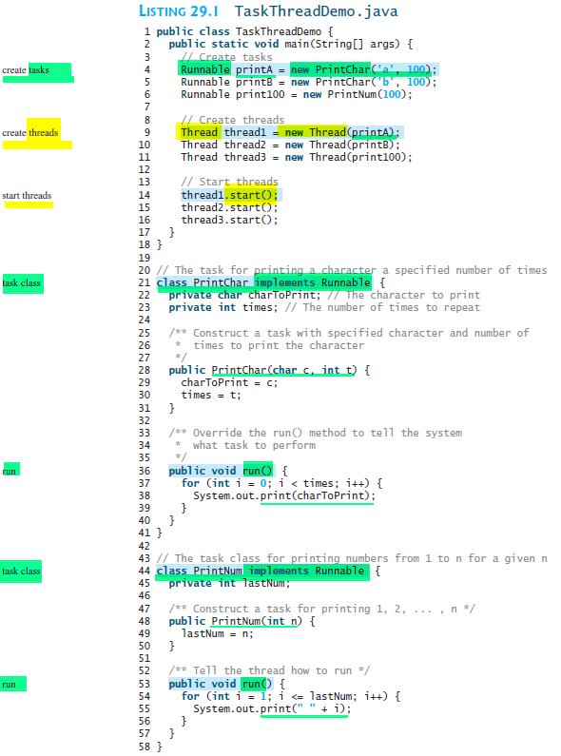

Slide 7
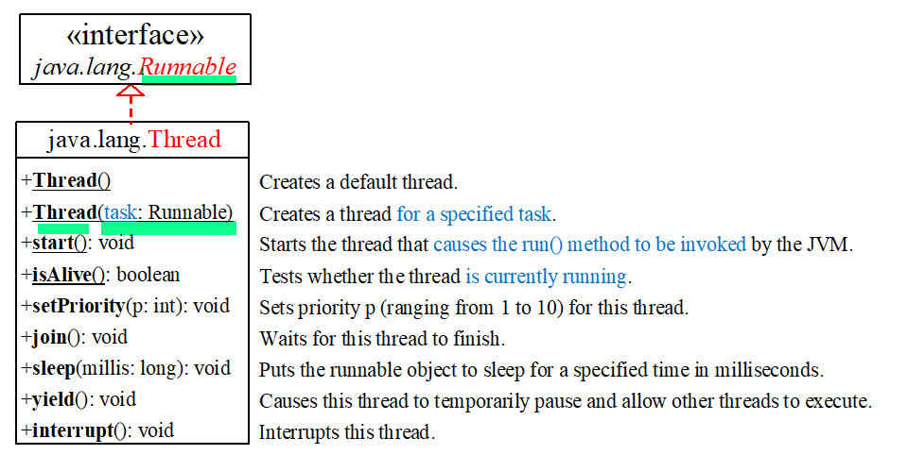
Thread Class

Slide 8
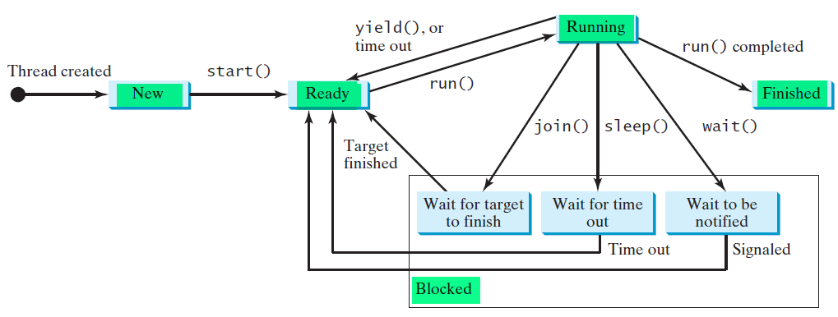
Thread States
Threads can be in one of five states
Threads can be in one of five states: New, Ready, Running,
Blocked, or Finished .
Notes:
When a thread is newly created, it enters the New state. After a thread is started by calling
its start() method, it enters the Ready state. A ready thread is runnable but may not be running
yet. The operating system has to allocate CPU time to it.
When a ready thread begins executing, it enters the Running state. A running thread may
enter the Ready state if its given CPU time expires or its yield() method is called.
A thread can enter the Blocked state (i.e., become inactive) for several reasons. It may have
invoked the join(), sleep(), or wait() method, or some other thread may have invoked
these methods. It may be waiting for an I/O operation to finish. A blocked thread may be reactivated
when the action inactivating it is reversed. For example, if a thread has been put to
sleep and the sleep time has expired, the thread is reactivated and enters the Ready state.
Finally, a thread is finished if it completes the execution of its run() method.
The isAlive() method is used to find out the state of a thread. It returns true if a thread
is in the Ready, Blocked, or Running state; it returns false if a thread is new and has not
started or if it is finished.
The interrupt() method interrupts a thread in the following way: If a thread is currently
in the Ready or Running state, its interrupted flag is set; if a thread is currently blocked, it
is awakened and enters the Ready state, and an java.lang.InterruptedException is
thrown.

Slide 9
Thread Priority
Java assigns every thread a priority.
Range：1-10 （high）
Some constants ：
Thread.MIN_PRIORITY ：1
Thread.NORM_PRIORITY ：5 （default priority）
Thread.MAX_PRIORITY ：10
By default, a thread’s priority: its parent-thread’ priority (that spawned it)
the main thread’s priority: Thread.NORM_PRIORITY.
Set/get the priority:
setPriority(int priority)
getPriority()
Notes:
Java assigns every thread a priority. By default, a thread inherits the priority of the thread that spawned产卵，引起 [spɔ:n] it.
You can increase or decrease the priority of any thread by using the setPriority method, and you can get the thread’s priority by using the getPriority method.
Priorities are numbers ranging from 1 to 10.
The Thread class has the int constants MIN_PRIORITY, NORM_PRIORITY, and MAX_PRIORITY, representing 1, 5, and 10, respectively.
The priority of the main thread is Thread.NORM_PRIORITY.
The JVM always picks the currently runnable thread with the highest priority.
A lowerpriority thread can run only when no higher-priority threads are running.
If all runnable threads have equal priorities, each is assigned an equal portion of the CPU time in a circular queue. This is called the round-robin scheduling.
For example, suppose you insert the following code in line 16 in TaskThreadDemo.java in Listing 29.1:
The thread for the print100 task will be finished first.
thread3.setPriority(Thread.MAX_PRIORITY);

Slide 10
Thread Priority
The JVM always picks the currently runnable thread with the highest priority.
A lowerpriority thread can run only when no higher-priority threads are running.
If all runnable threads have equal priorities, each is assigned an equal portion of the CPU time in a circular queue. This is called the round-robin scheduling.
e.g., insert the following code at line 16 in previous example:
thread3.setPriority(Thread.MAX_PRIORITY);
The thread3 will be finished first.
Notes:
Java assigns every thread a priority. By default, a thread inherits the priority of the thread that spawned产卵，引起 [spɔ:n] it.
You can increase or decrease the priority of any thread by using the setPriority method, and you can get the thread’s priority by using the getPriority method.
Priorities are numbers ranging from 1 to 10.
The Thread class has the int constants MIN_PRIORITY, NORM_PRIORITY, and MAX_PRIORITY, representing 1, 5, and 10, respectively.
The priority of the main thread is Thread.NORM_PRIORITY.
The JVM always picks the currently runnable thread with the highest priority.
A lowerpriority thread can run only when no higher-priority threads are running.
If all runnable threads have equal priorities, each is assigned an equal portion of the CPU time in a circular queue. This is called the round-robin scheduling.
For example, suppose you insert the following code in line 16 in TaskThreadDemo.java in Listing 29.1:
The thread for the print100 task will be finished first.
thread3.setPriority(Thread.MAX_PRIORITY);

Slide 11
Static yield() Method
Temporarily release time for other threads.
e.g., modify Lines 53-57 as follows:
public void run() {
for (int i = 1; i <= lastNum; i++) {
System.out.print(" " + i);
Thread.yield();
}
}
Every time a number is printed, the print100 thread is yielded.
So, each number (print100 thread) is followed by some characters (printA/printB thread).

Slide 12
Static sleep(milliseconds) Method
Puts the thread to sleep for the specified time in milliseconds.
e.g., modify Lines 53-57 as follows:
public void run() {
for (int i = 1; i <= lastNum; i++) {
System.out.print(" " + i);
try {
if (i >= 50) Thread.sleep(1);
}
catch (InterruptedException ex) {
}
}
}
Every time a number (>= 50) is printed,
the print100 thread is put to sleep for 1 millisecond.

Slide 13
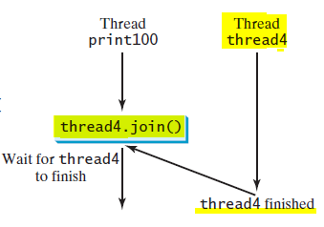
join() Method
Force one thread to wait for another thread to finish.
e.g., modify Lines 53-57 as follows:
The numbers > 50 are printed after thread4 is finished.

Slide 14
Thread States
Threads can be in one of five states
Threads can be in one of five states: New, Ready, Running,
Blocked, or Finished
Notes:
When a thread is newly created, it enters the New state. After a thread is started by calling
its start() method, it enters the Ready state. A ready thread is runnable but may not be running
yet. The operating system has to allocate CPU time to it.
When a ready thread begins executing, it enters the Running state. A running thread may
enter the Ready state if its given CPU time expires or its yield() method is called.
A thread can enter the Blocked state (i.e., become inactive) for several reasons. It may have
invoked the join(), sleep(), or wait() method, or some other thread may have invoked
these methods. It may be waiting for an I/O operation to finish. A blocked thread may be reactivated
when the action inactivating it is reversed. For example, if a thread has been put to
sleep and the sleep time has expired, the thread is reactivated and enters the Ready state.
Finally, a thread is finished if it completes the execution of its run() method.
The isAlive() method is used to find out the state of a thread. It returns true if a thread
is in the Ready, Blocked, or Running state; it returns false if a thread is new and has not
started or if it is finished.
The interrupt() method interrupts a thread in the following way: If a thread is currently
in the Ready or Running state, its interrupted flag is set; if a thread is currently blocked, it
is awakened and enters the Ready state, and an java.lang.InterruptedException is
thrown.

Slide 15
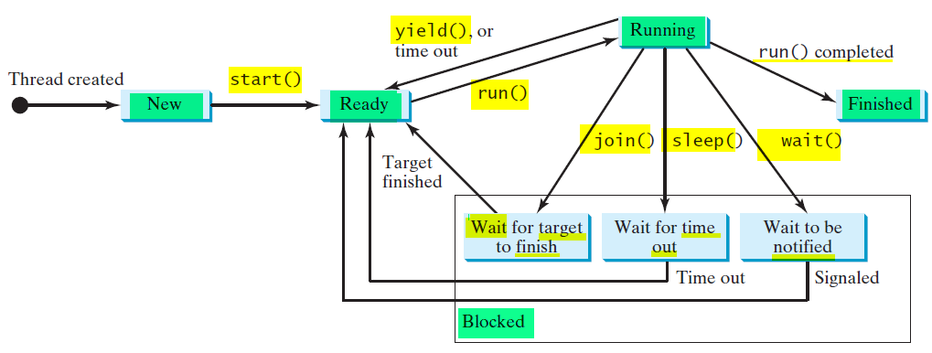
Thread States
Threads can be in one of five states
Threads can be in one of five states: New, Ready, Running,
Blocked, or Finished
Notes:
When a thread is newly created, it enters the New state. After a thread is started by calling
its start() method, it enters the Ready state. A ready thread is runnable but may not be running
yet. The operating system has to allocate CPU time to it.
When a ready thread begins executing, it enters the Running state. A running thread may
enter the Ready state if its given CPU time expires or its yield() method is called.
A thread can enter the Blocked state (i.e., become inactive) for several reasons. It may have
invoked the join(), sleep(), or wait() method, or some other thread may have invoked
these methods. It may be waiting for an I/O operation to finish. A blocked thread may be reactivated
when the action inactivating it is reversed. For example, if a thread has been put to
sleep and the sleep time has expired, the thread is reactivated and enters the Ready state.
Finally, a thread is finished if it completes the execution of its run() method.
The isAlive() method is used to find out the state of a thread. It returns true if a thread
is in the Ready, Blocked, or Running state; it returns false if a thread is new and has not
started or if it is finished.
The interrupt() method interrupts a thread in the following way: If a thread is currently
in the Ready or Running state, its interrupted flag is set; if a thread is currently blocked, it
is awakened and enters the Ready state, and an java.lang.InterruptedException is
thrown.

Slide 16
interrupt(), isInterrupted()
interrupt() : interrupts a thread
If a thread is currently in the Ready/Running state
Set its interrupted flag ;
if a thread is currently Blocked
it is awakened and enters Ready state
an java.io.InterruptedException is thrown.
isInterrupt() : tests whether the thread is interrupted.

Slide 17
isAlive()
isAlive() :
true: a thread is in Ready /Running /Blocked state;
false: New&NotStarted / Finished.
To stop/finish a thread :
Assign null to a Thread variable
rather than use the stop() method : outdated

Slide 18
Outdated methods: stop(), suspend(), resume()
Thread class also contains methods: stop(), suspend(), and resume().
As of Java 2, these methods are deprecated (or outdated)
because they are unsafe.
Notes:
Deprecated 不赞成，反对;

Slide 19


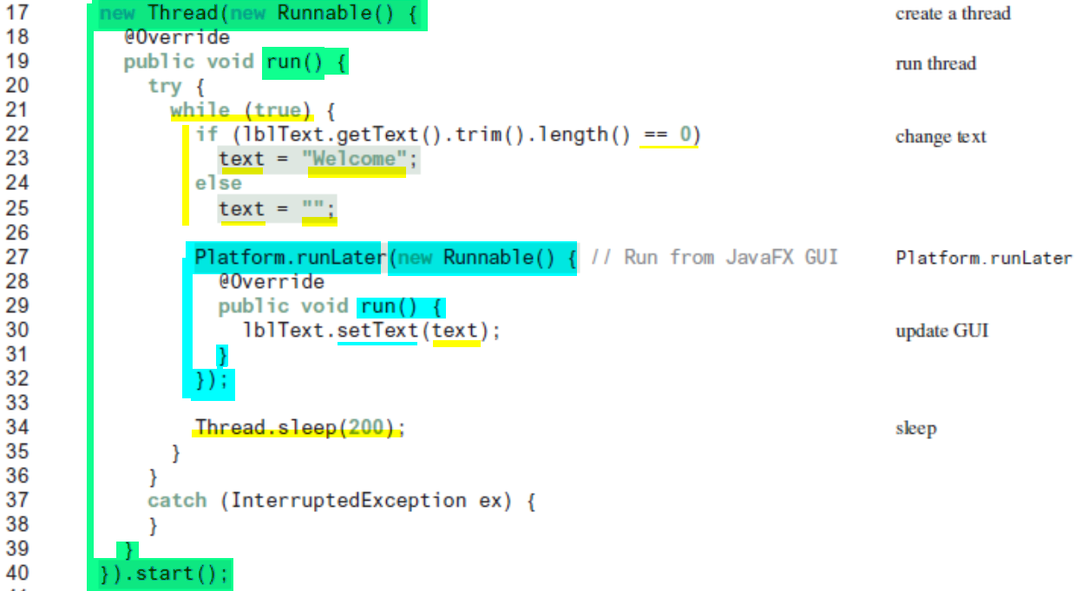
Notes:
text is set and unset to simulate a flashing effect

Slide 20
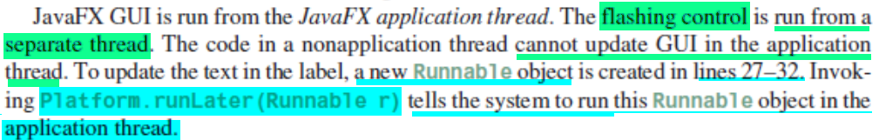

Slide 21
Thread Pools
A Thread Pool : manage the tasks executing concurrently.
Starting a new thread for each task could cause poor performance.
Executor interface for executing tasks in a thread pool ExecutorService interface for managing tasks.
ExecutorService is a subinterface of Executor.
Notes:
JDK 1.5 :

Slide 22
Creating Executors
To create an Executor object,
use the static methods in the Executors class:

Slide 23
Thread Synchronization
A shared resource may be corrupted if it is accessed simultaneously by multiple threads.
e.g., two unsynchronized threads accessing the same bank account (shared data member “.balance”) may cause conflict.
two threads: each adds a penny to an account; the account is initially 0.
thread[i] did nothing: results are overwritten
Notes:
The effect of this scenario is that Task 1 did nothing, because in Step 4 Task 2 overrides Task 1's result.

Slide 24
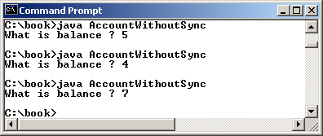
Example: Showing Resource Conflict
Suppose that you create and launch one hundred threads, each of which adds a penny to an account. Assume that the account is initially 0.
Notes:
Objective: Write a program that demonstrates the problem of resource conflict.
Results: un-deterministic

Slide 25
Race Condition
Race condition among multi-threads: multi-threads are accessing a shared resource in a way that causes conflict.
Lead to : Not thread-safe class
A class is thread-safe : if an object of the class does not cause a race condition in the presence of multiple threads.

Slide 26
synchronized method
To avoid race conditions:
Prevent more than one thread from simultaneously entering certain part of the program, known as critical region.
Use the synchronized keyword to synchronize the method so that only one thread can access the method at a time.
public synchronized void deposit(double amount)
Notes:
The critical region in the Listing 29.7 is : deposit() method.
There are several ways to correct the problem in Listing 29.7
one approach is to make Account thread-safe: by adding the synchronized keyword in the deposit method in Line 45 as follows:

Slide 27
synchronized Block /Statements
Synchronized block ： synchronized statements
synchronized (expr) {
statements;
}
expr ：an object reference.
If the object is already locked by another thread, the thread is blocked.
If a lock is obtained on the object, the synchronized block is executed, and then the lock is released.
Notes:
A synchronized statement can be used to acquire a lock on any object, not just this object, when executing a block of the code in a method.

Slide 28
Synchronizing block vs. Method
a synchronized method:
public synchronized void xMethod() {
// method body
}
equivalent to a synchronized block:
public void xMethod() {
synchronized (this) {
// method body
}
}
Notes:
Any synchronized instance method can be converted into a synchronized statement. Suppose that the following is a synchronized instance method:

Slide 29
Synchronization Using Locks
A lock is an instance of the Lock interface, which declares the methods for acquiring and releasing locks.
Notes:
A synchronized instance method implicitly acquires a lock on the instance before it executes the method.
JDK 1.5 enables you to use locks explicitly. The new locking features are flexible and give you more control for coordinating threads.
A lock may also use the newCondition() method to create any number of Condition objects, which can be used for thread communications.

Slide 30
Thread Cooperation
A thread can specify what to do under a certain condition.
Condition:
object created by invoking newCondition() on a Lock object.
methods:
await(), signal(), signalAll()

Slide 31
Example: Thread Cooperation
Two cooperated threads: Deposit & Withdraw ,
use a lock with a condition: newDeposit
Withdraw thread : wait for the newDeposit condition
if the balance is less than the amount to be withdrawn
Deposit thread: signals the waiting Withdraw thread to try again
when adding money to the account
Notes:
The interaction between the two tasks is shown in Figure 29.16.
newDeposit (i.e., new deposit added to the account).

Slide 32
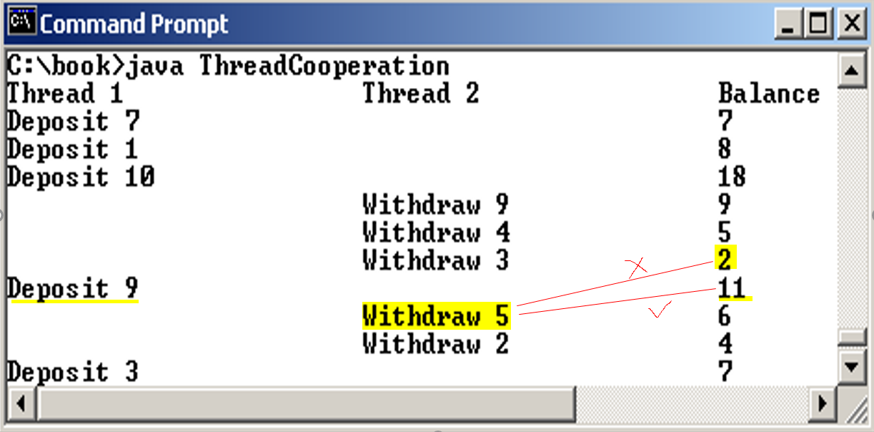
Example: Thread Cooperation
two threads: one deposits to an account, one withdraws from it.
the initial balance is 0
the amount to deposit/withdraw is random.
Notes:
Withdraw thread waits, if the amount to be withdrawn is more than the current account balance
Deposit thread notifies the Withdraw thread to resume, whenever new fund is deposited to the account,
If the amount is still not enough, the Withdraw thread continue to wait.

